Slide 1
AskDB
AI-Powered Data Query Interface
Team – Code Clan

Slide 2
Introduction
AskDB is a powerful AI-driven application that revolutionizes the way you interact with your data. Organizations often struggle with efficiently accessing and understanding client data stored in internal databases, leading to delays in decision-making and inefficiencies in client management. AskDB addresses this need by allowing users to ask natural language questions and receive precise answers from uploaded files such as Excel and CSV. It supports multiple languages, displays the generated SQL queries, and offers various visualization options to enhance data interpretation. Let’s dive into a live demonstration to show you how it works and explore its key features in detail.

Slide 3
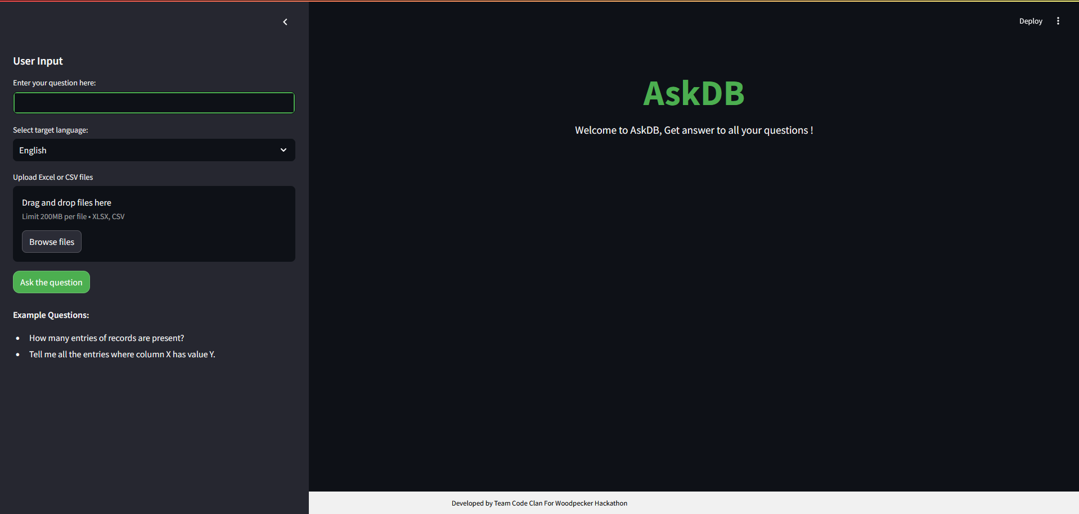
User Interface

Slide 4
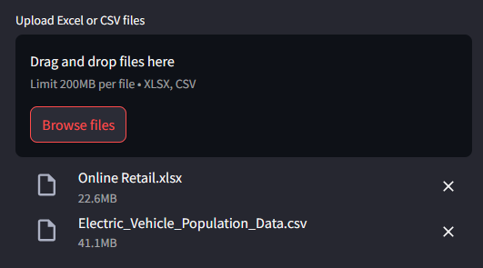
Database Integration
Multi-file Uploads: Supports uploading multiple Excel or CSV files.
Seamless Integration: Combines single or multiple files into a single SQLite in-memory database.
Comprehensive Querying: Allows queries across all uploaded datasets.

Slide 5
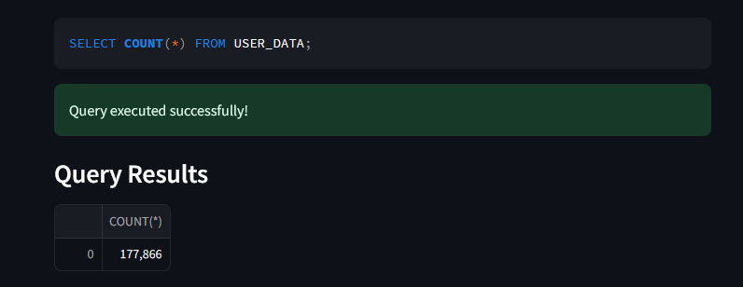
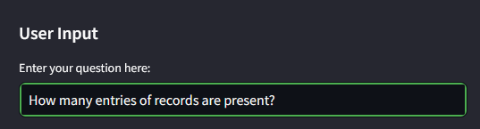
Dynamic Querying
Natural Language Processing: Converts user questions into SQL queries.
Accurate Data Retrieval: Ensures precise results from the combined database.
Example: Asking "How many entries of records are present?" generates and executes the relevant SQL query.
Output
Input

Slide 6
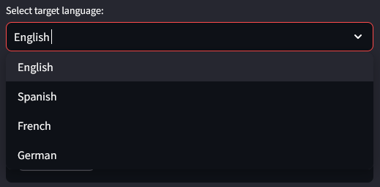
Multilingual Support
Global Accessibility: Designed for users worldwide.
Multiple Languages: Supports English, Spanish, German, French & other languages.
User-Friendly Interface: Simplifies interactions for non-English speakers.

Slide 7
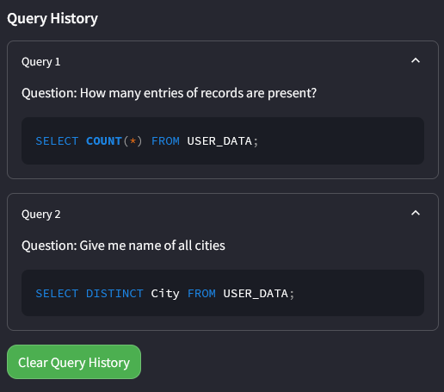
Query History
Query History: Maintains a record of all queries made for transparency & data retrieval.
Easy Review and Management: Allows users to review and manage past queries effortlessly.
Delete History: Provides an option to delete query history as needed.

Slide 8

Dynamic Result Handling Options
Download icon: Allows you to download the table data.
Magnifying glass icon: Enables search functionality to find specific entries in the table.
Settings icon: Provides options to adjust the table's settings and display preferences.

Slide 9
Additional Features
Data Visualizations: Provides various visualization options for better data interpretation.
Download Result: Allows users to download results as CSV files.
Search Option: Includes a search feature to find specific information within the results.

Slide 10
Conclusion
In conclusion, AskDB is a significant advancement in data querying and analysis, leveraging Generative AI to simplify and enhance user interaction with complex datasets. Its robust feature set, including database integration, multilingual support, comprehensive visualization options, and real-time feedback, makes it a valuable tool for users seeking efficient and accessible data analysis solutions.

